Slide 2
Library Components in SPFx
Nanddeep Nachan

Slide 3












Nanddeep Nachan
Consultant - SharePoint, Office 365, MS Azure
Speaker | Author | Blogger
Microsoft Certified Professional
Certified Scrum Master (CSM)
Certified Professional Photographer
NanddeepNachan@gmail.com
@NanddeepNachan
/in/nanddeepnachan
https://nanddeepnachanblogs.com
nanddeepnachan
nanddeepn

Slide 4
Introduction to SPFx Library Components
Simultaneous Parallel Development
Microsoft Rush to manage SPFx monorepo projects with library components

Slide 5
Introduction to SPFx Library Components
What are SharePoint Library Components?
Challenges solved with Library Components
Accessing Library Component Functionality
Availability behind the scenes: Web Part & Extension Development

Slide 6
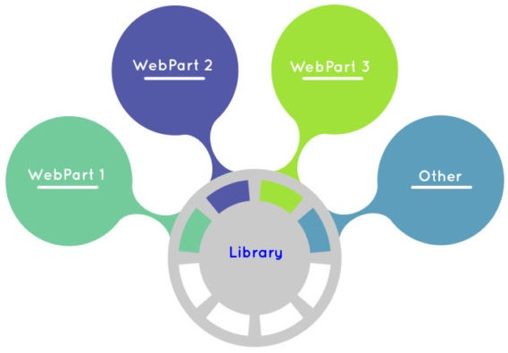
Library Component
GA in SPFx v1.9.1
Alternative option to create shared code
Independently versioned and deployed
It can be referenced across all components in the tenant

Slide 7




What are SharePoint Library Components?
SharePoint Framework
.sppkg Solution

Slide 8
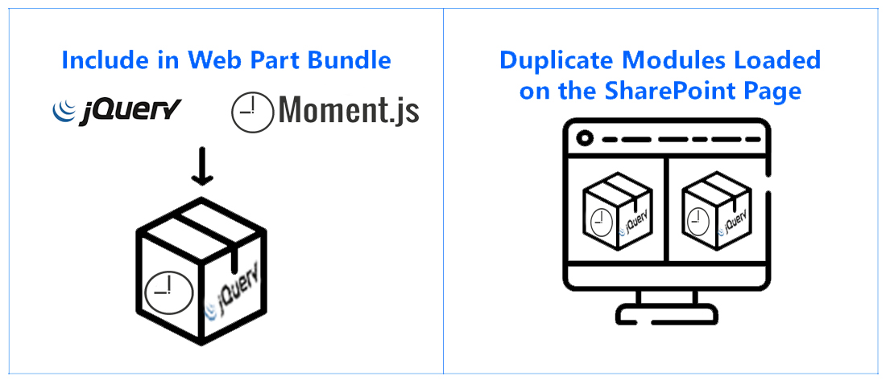
Challenges without Library Components

Slide 9
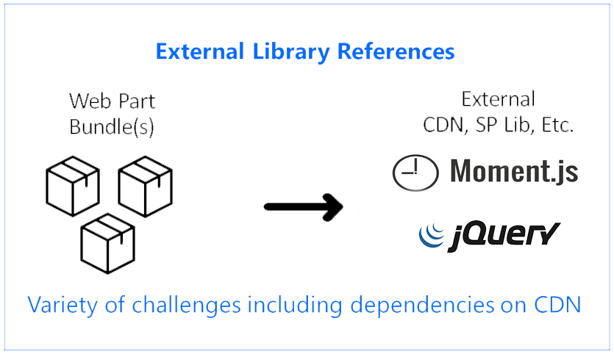
Challenges without Library Components

Slide 10
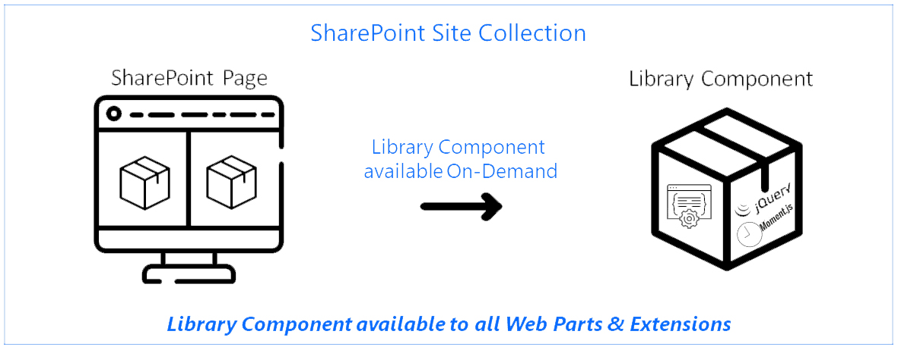
Challenges solved with Library Components

Slide 11
SPFx Library Characteristics
You can host only one library component version at the time in a tenant.
It is not supported to have other component types included in a solution which contains library component.
Library components are not supported when solution is deployed using site collection app catalog.

Slide 12
Develop Library Component

Slide 13
SharePoint Library Components Simultaneous Parallel Development
Developing a Library Component & Web Part or Extension Simultaneously in Parallel
Gulp Serve both at the same time
Changes required to avoid port conflicts
Benefits of simultaneous parallel development

Slide 14
Achieve Simultaneous Parallel Development
Gulp Serve on both the Library Component & Web Part / Extension
Requires changing the serve.json port used for the Library Component
Ensures there are no localhost port conflicts or collisions between solutions
Connection to Library Component is based on the ‘NPM Link’
Benefit: Gulp task runner watches for changes and automatically rebuilds

Slide 15
Simultaneous Parallel Development

Slide 16

Using Microsoft Rush to manage SPFx projects with Library Components

Slide 17
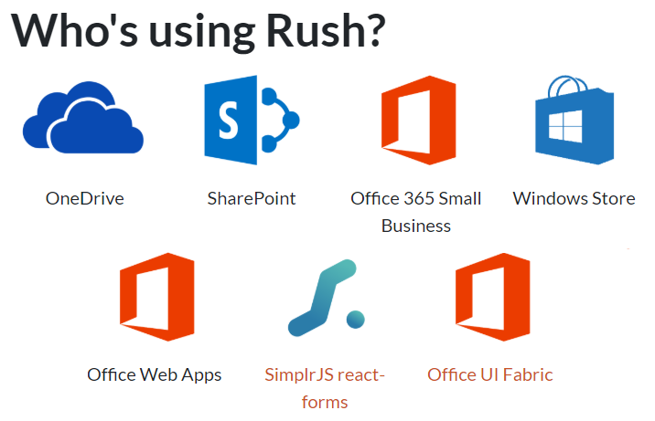
Microsoft Rush
A scalable monorepo manager for the web
Manage large repositories (monorepos) containing multiple node/npm projects with dependencies on each other
npm install -g @microsoft/rush
https://rushjs.io/

Slide 18
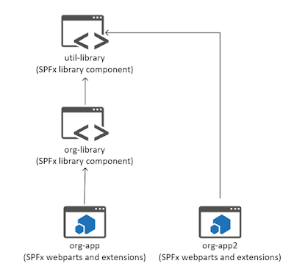
Manage large SPFx repositories

Slide 19
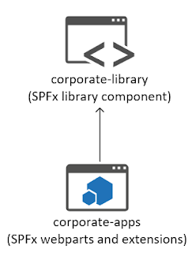
Simple Rush Repository

Slide 20
Benefits of Microsoft Rush
No need to manage node_modules folders individually for each project. Rush will maintain a common node_modules folder.
Rush will create a single lock file for your entire repository.
Rush handles all the linking and unlinking.
No need to run gulp build multiple times. Just run "rush build" once.
Rush will keep track of which webpart depends on which library.
Based on project dependencies, Rush will parallelise builds of projects which do not depend on each other, reducing build time.

Slide 21

Complex Rush Repository

Slide 22
Microsoft Rush to manage SPFx projects with Library Components

Slide 23
SPFx Library Commands Cheat Sheet
Command | Description
npm link | symlink a package folder (library component).
npm ls -g <library-name> | Check the folder location of SPFx library.
npm unlink <library-name> | Unlink an SPFx library that was symlinked during development in your SPFx project, navigate to SPFx web part solution’s root folder and run the command.
npm unlink | Remove local npm link to the library, navigate to the SPFx library solution’s root folder and run the command.

Slide 24
References
Library Component Overview
https://docs.microsoft.com/en-us/sharepoint/dev/spfx/library-component-overview
Library Component Tutorial
https://docs.microsoft.com/en-us/sharepoint/dev/spfx/library-component-tutorial
http://warner.digital/sharepoint-library-components-introduction/
Using Microsoft Rush to manage SPFx projects with library components
https://www.vrdmn.com/2019/04/using-microsoft-rush-to-manage-spfx.html
Sample Code
https://github.com/nanddeepn/code-samples/tree/master/SPFx/WebParts/spfx-library-component

Slide 25
NanddeepNachan@gmail.com
@NanddeepNachan
/in/nanddeepnachan
https://nanddeepnachanblogs.com
nanddeepnachan
nanddeepn

